Slide 1
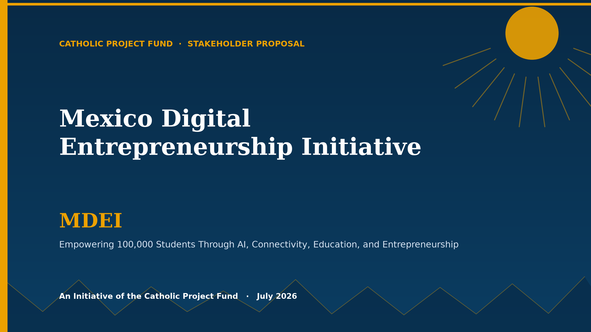

Slide 2
AGENDA
What We Will Cover
› The Opportunity
› Program Goals
› The Student Package
› Technology Ecosystem
› Theory of Change
› Implementation Roadmap
› Governance & Leadership
› Financial Model
› Fundraising & Sponsorship
› Risk Management
› Monitoring & Impact
› Sustainability & Vision
› Mexico Deployment
› Call to Action
Catholic Project Fund · MDEI Stakeholder Presentation
2

Slide 3
Executive Summary
A twelve-month, $240,000,000 initiative sponsored by the Catholic Project Fund to turn 100,000 students across Mexico into digital entrepreneurs — with hardware, connectivity, AI, payments, and training bundled into a single $2,400 package per student.
100,000
$240M
8
12
$2,400
5
Sponsored Students
Total Budget
Regions
Months
Per Student
Tech Partners
› Five integrated platforms — Jozie AI, Torvali, SCM Financials, Beezifi, YouLabs — give every student a full business infrastructure
› A disciplined 12-month roadmap moves from governance through deployment, curriculum, and a Month-12 graduation showcase
› Five sponsorship tiers scale from $2,400 (one student) to $24,000,000 (10,000 students, Global Partner)
Catholic Project Fund · MDEI Stakeholder Presentation
3

Slide 4
The Opportunity
› 45M+ people under 25 across Mexico — mobile-fluent and entrepreneurially minded
› 1 in 3 households lacks reliable home internet access
› Youth unemployment exceeds 18% in several target markets
› AI has collapsed the cost of running a business — but only for those with a device, connectivity, and training
› Device-only donation programs consistently underperform: fewer than 1 in 5 donated laptops remained in active use after 18 months in comparable efforts
Catholic Project Fund · MDEI Stakeholder Presentation
4

Slide 5
Program Goals
$240,000,000 — 100,000 students × $2,400. One transparent unit economic model.
Total funds raised
$240,000,000
Students sponsored
100,000
Regions reached
8
Program duration
12 months
Student businesses launched
≥ 92,000 (92%)
Students with a first sale
≥ 78,000 (78%)
Catholic Project Fund · MDEI Stakeholder Presentation
5

Slide 6
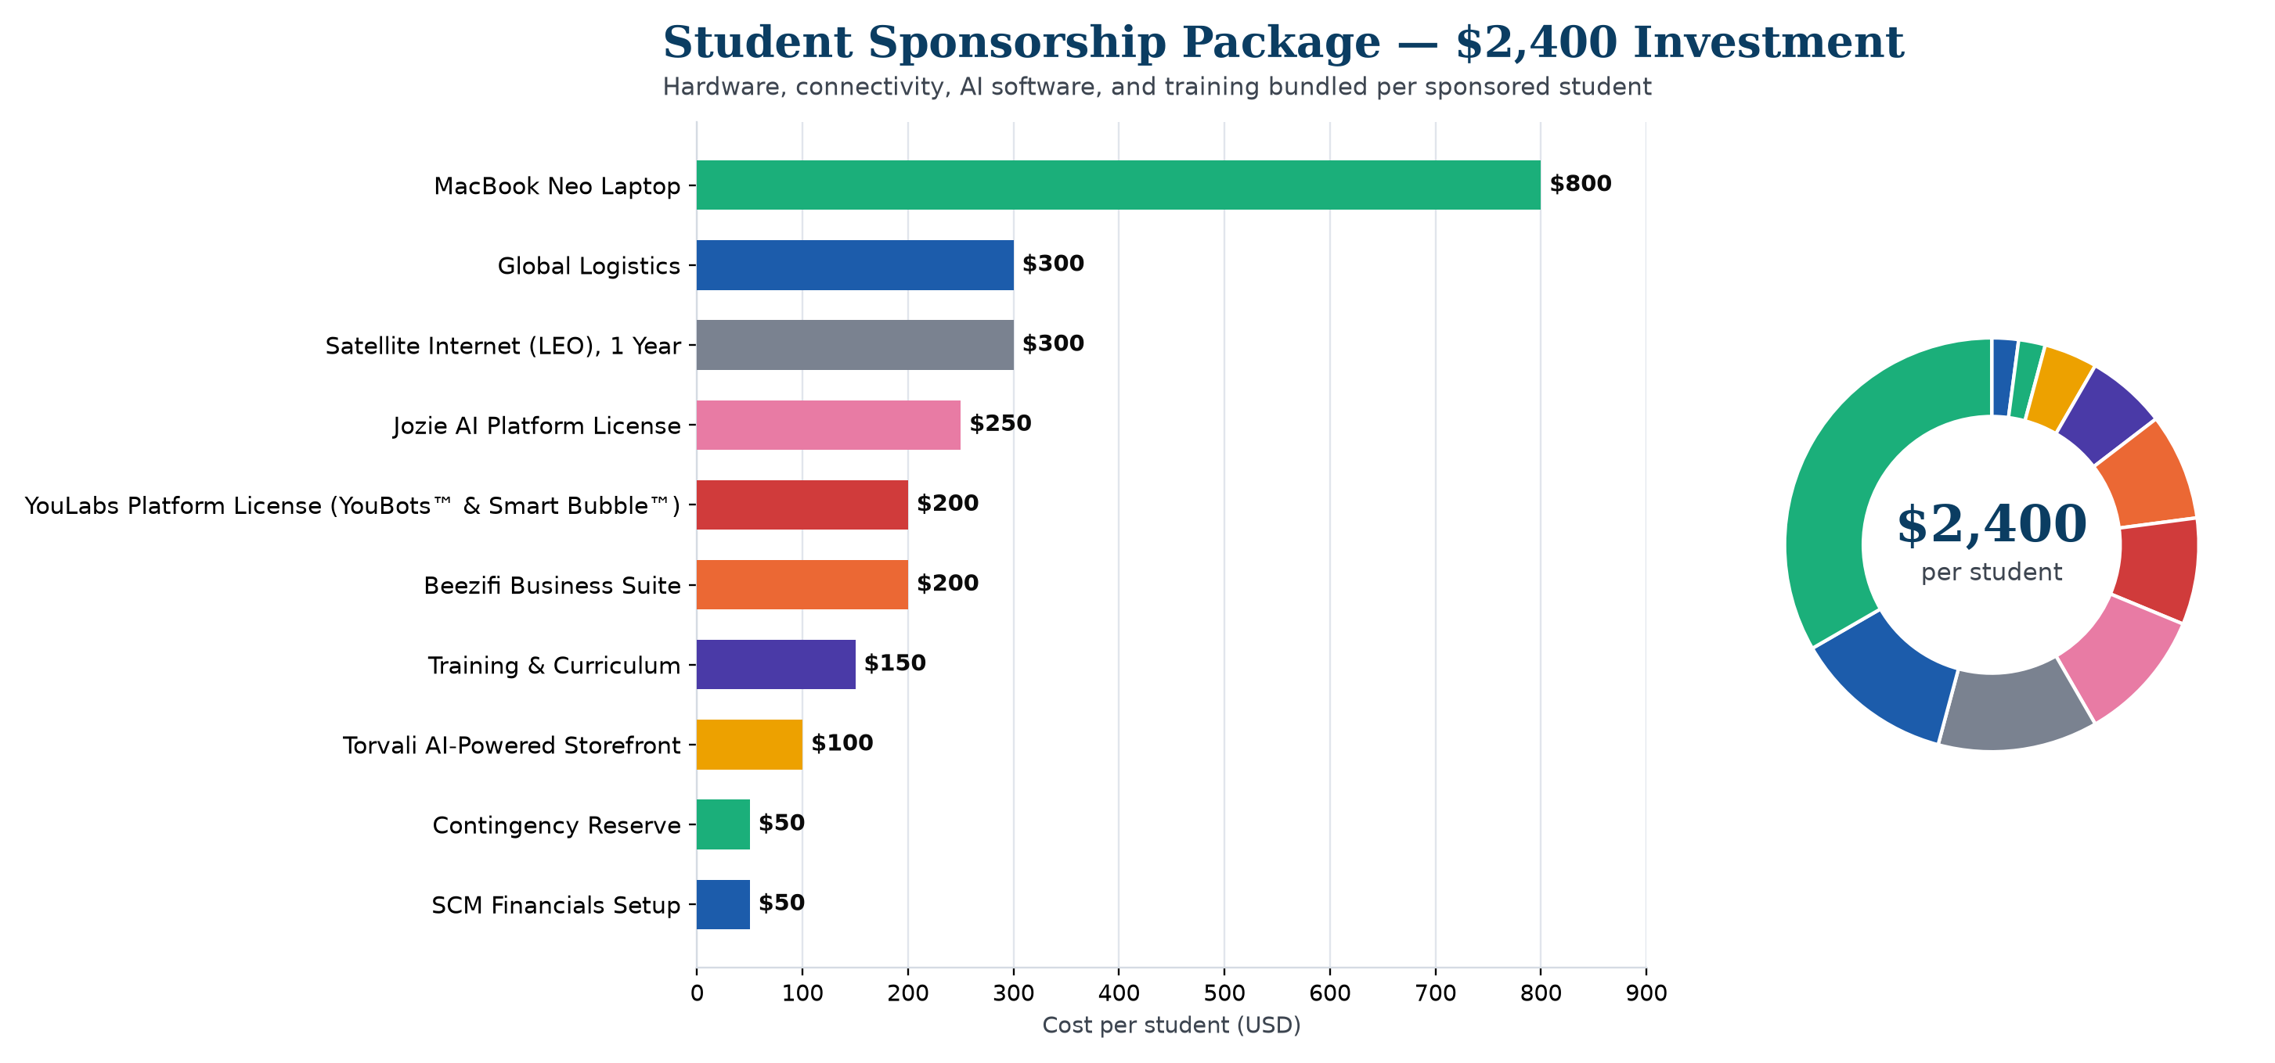
$2,400 PER STUDENT
The Student Package
Catholic Project Fund · MDEI Stakeholder Presentation
6

Slide 7
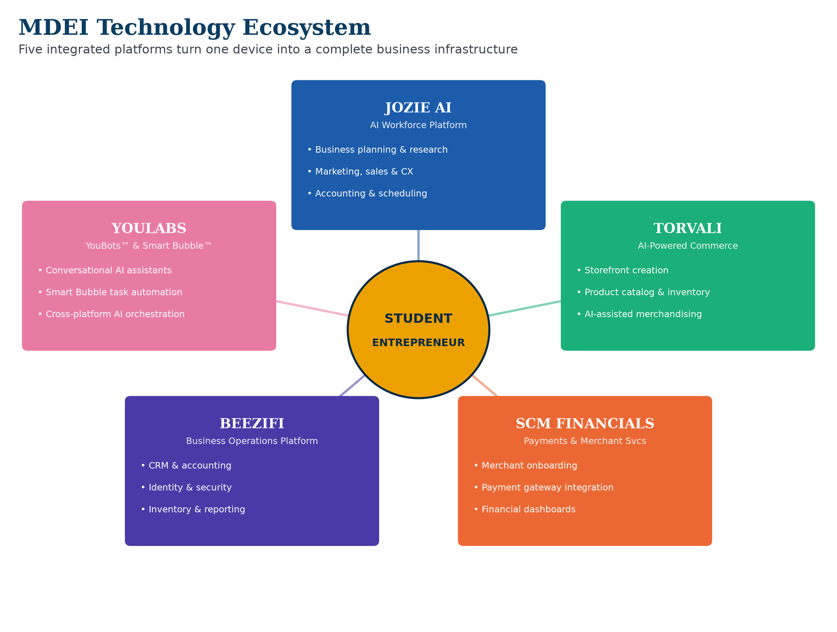
The MDEI Technology Ecosystem
Catholic Project Fund · MDEI Stakeholder Presentation
7

Slide 8
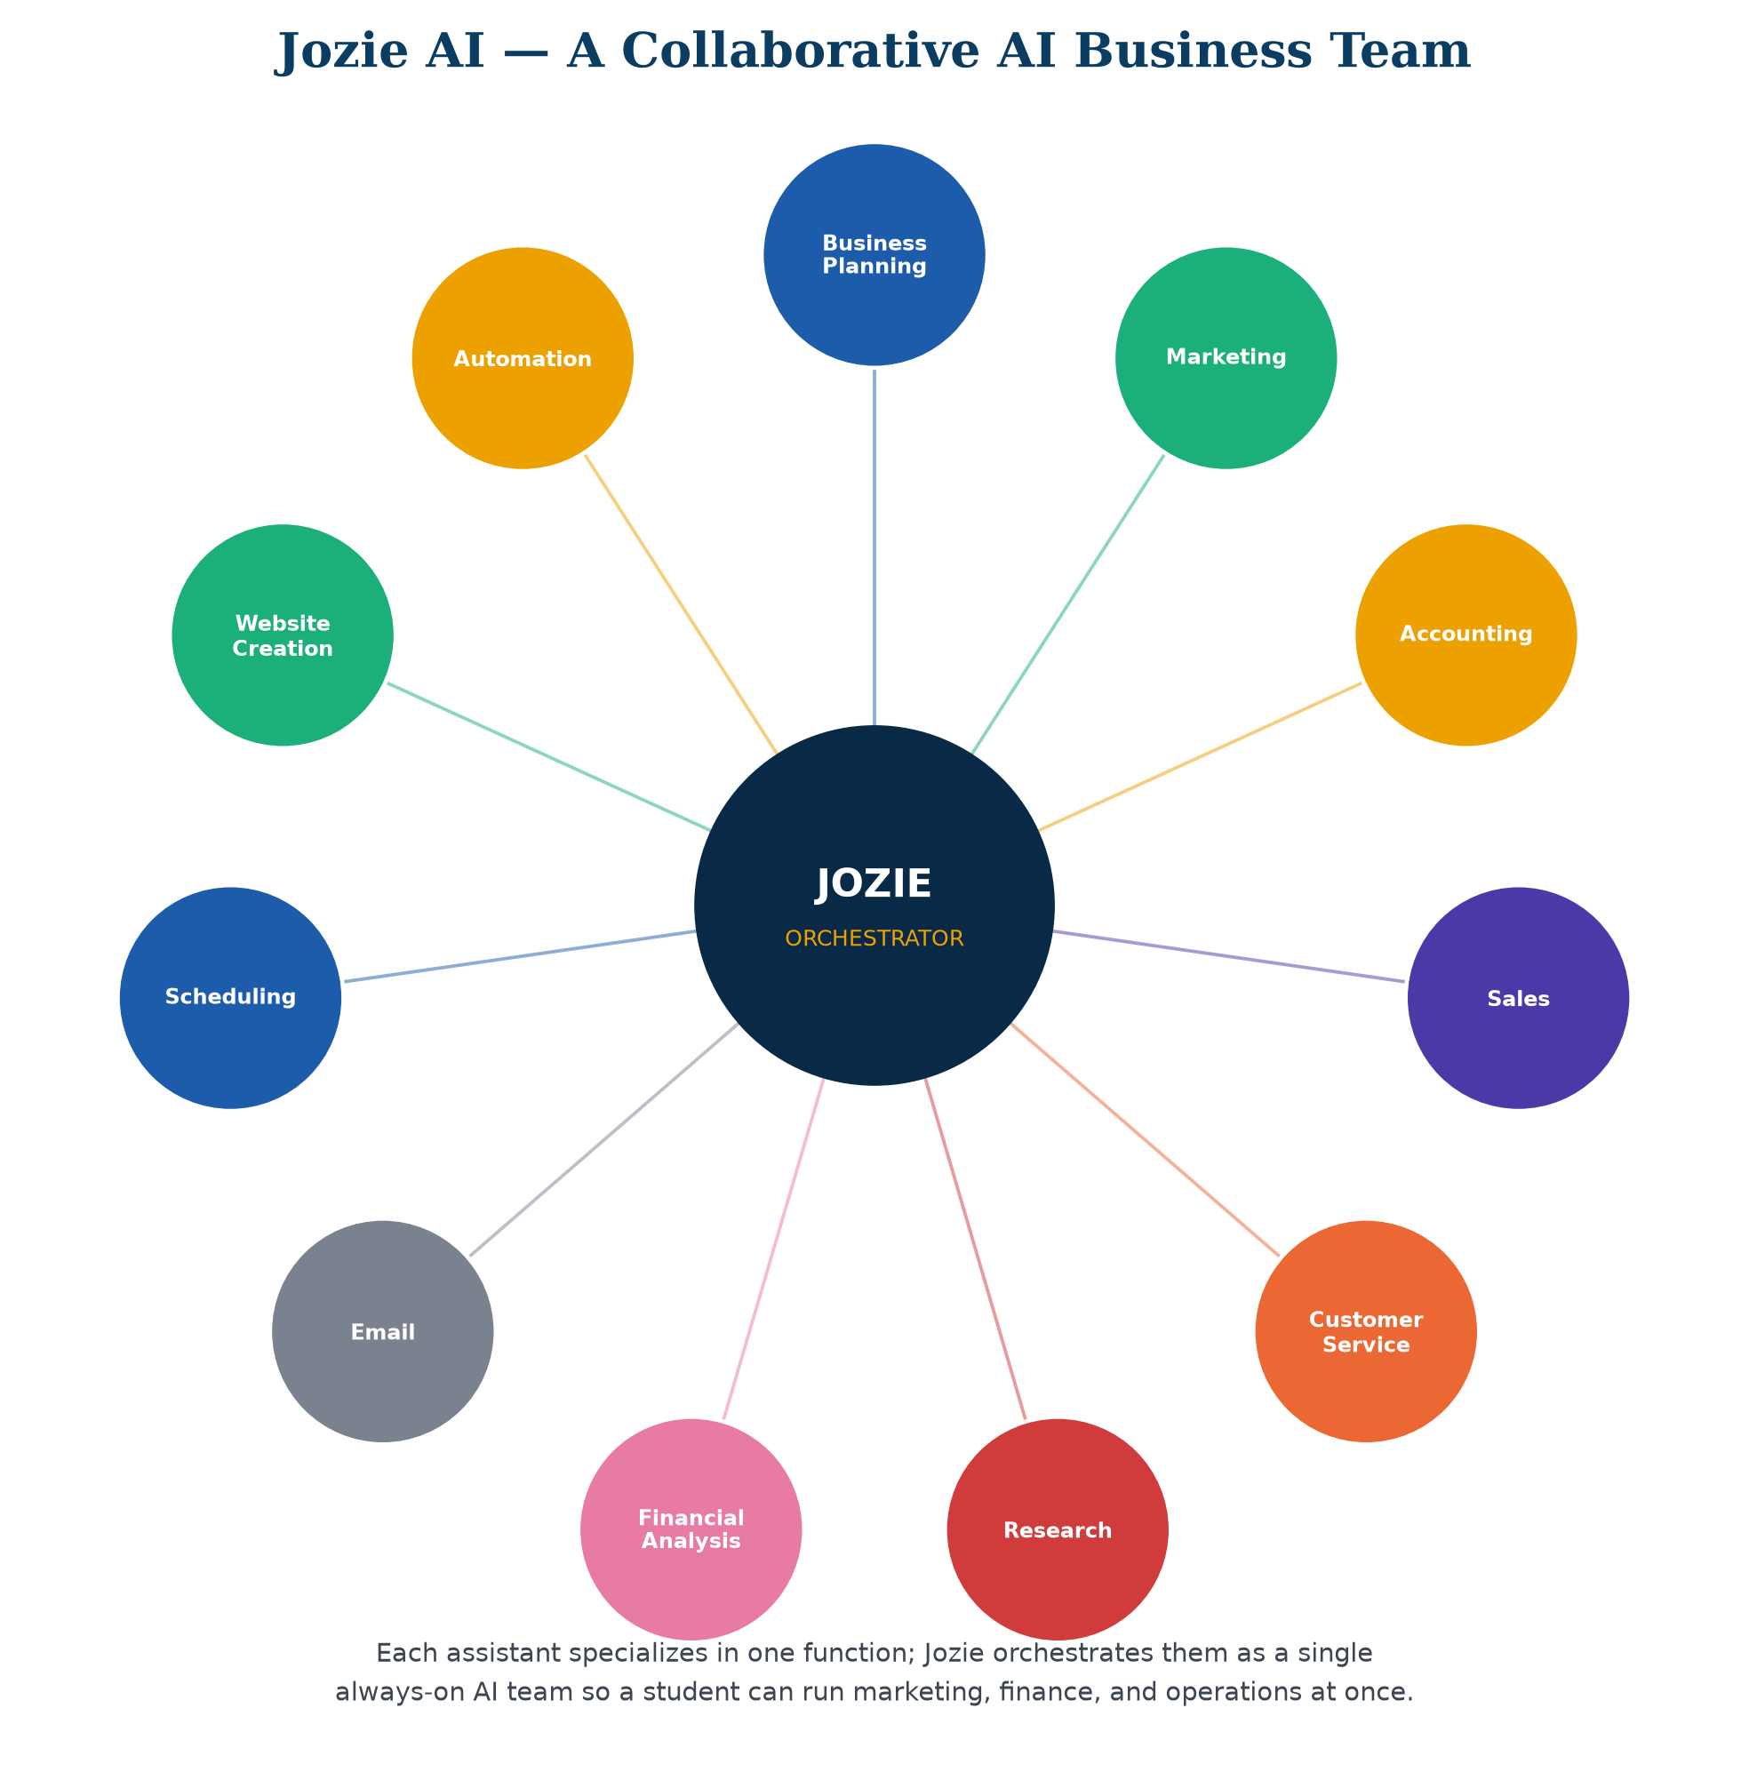
Jozie AI — The AI Workforce Platform
› Business planning, marketing, accounting, sales & customer service
› Research, financial analysis, email, scheduling, website creation
› Assistants collaborate as one coordinated AI team
Catholic Project Fund · MDEI Stakeholder Presentation
8

Slide 9
Torvali — AI-Powered Commerce
› Storefront creation in under an hour, AI-assisted
› Product catalog, inventory & order management
› AI-assisted merchandising and plain-language analytics
Catholic Project Fund · MDEI Stakeholder Presentation
9

Slide 10
SCM Financials — Payments & Merchant Services
› Merchant onboarding built for first-time entrepreneurs
› Card acceptance and regional digital wallets
› Financial dashboards and settlement reporting
Catholic Project Fund · MDEI Stakeholder Presentation
10

Slide 11
Beezifi — Business Operations Platform
› CRM, accounting, identity & security
› Agreements, documents & inventory management
› The operating backbone that keeps a business organized
Catholic Project Fund · MDEI Stakeholder Presentation
11

Slide 12
YouLabs — YouBots™ & Smart Bubble™
› YouBots™ — conversational AI tutoring assistants
› Smart Bubble™ — immersive, scenario-based learning simulations
› Powers the digital literacy, AI, and entrepreneurship curriculum
Catholic Project Fund · MDEI Stakeholder Presentation
12

Slide 13
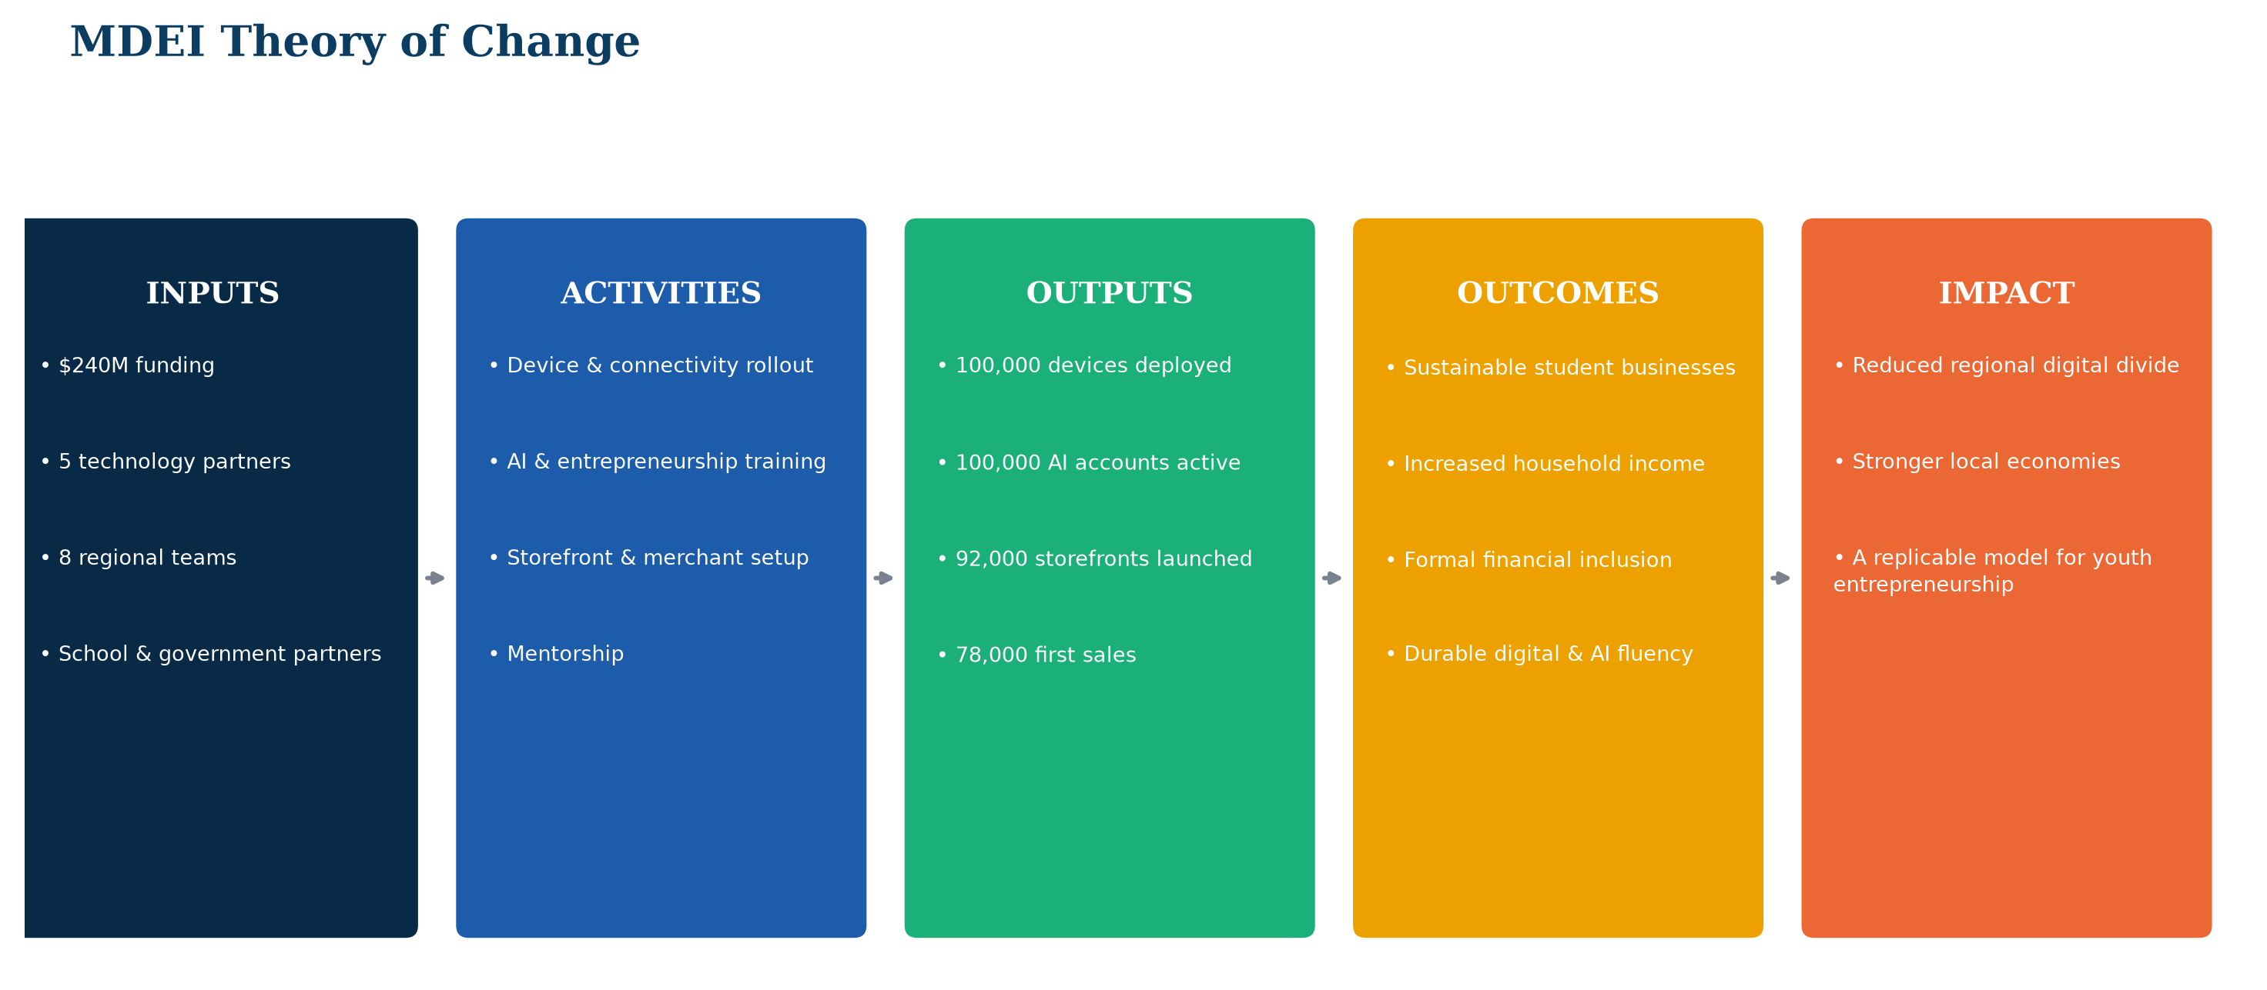
Theory of Change
Catholic Project Fund · MDEI Stakeholder Presentation
13

Slide 14
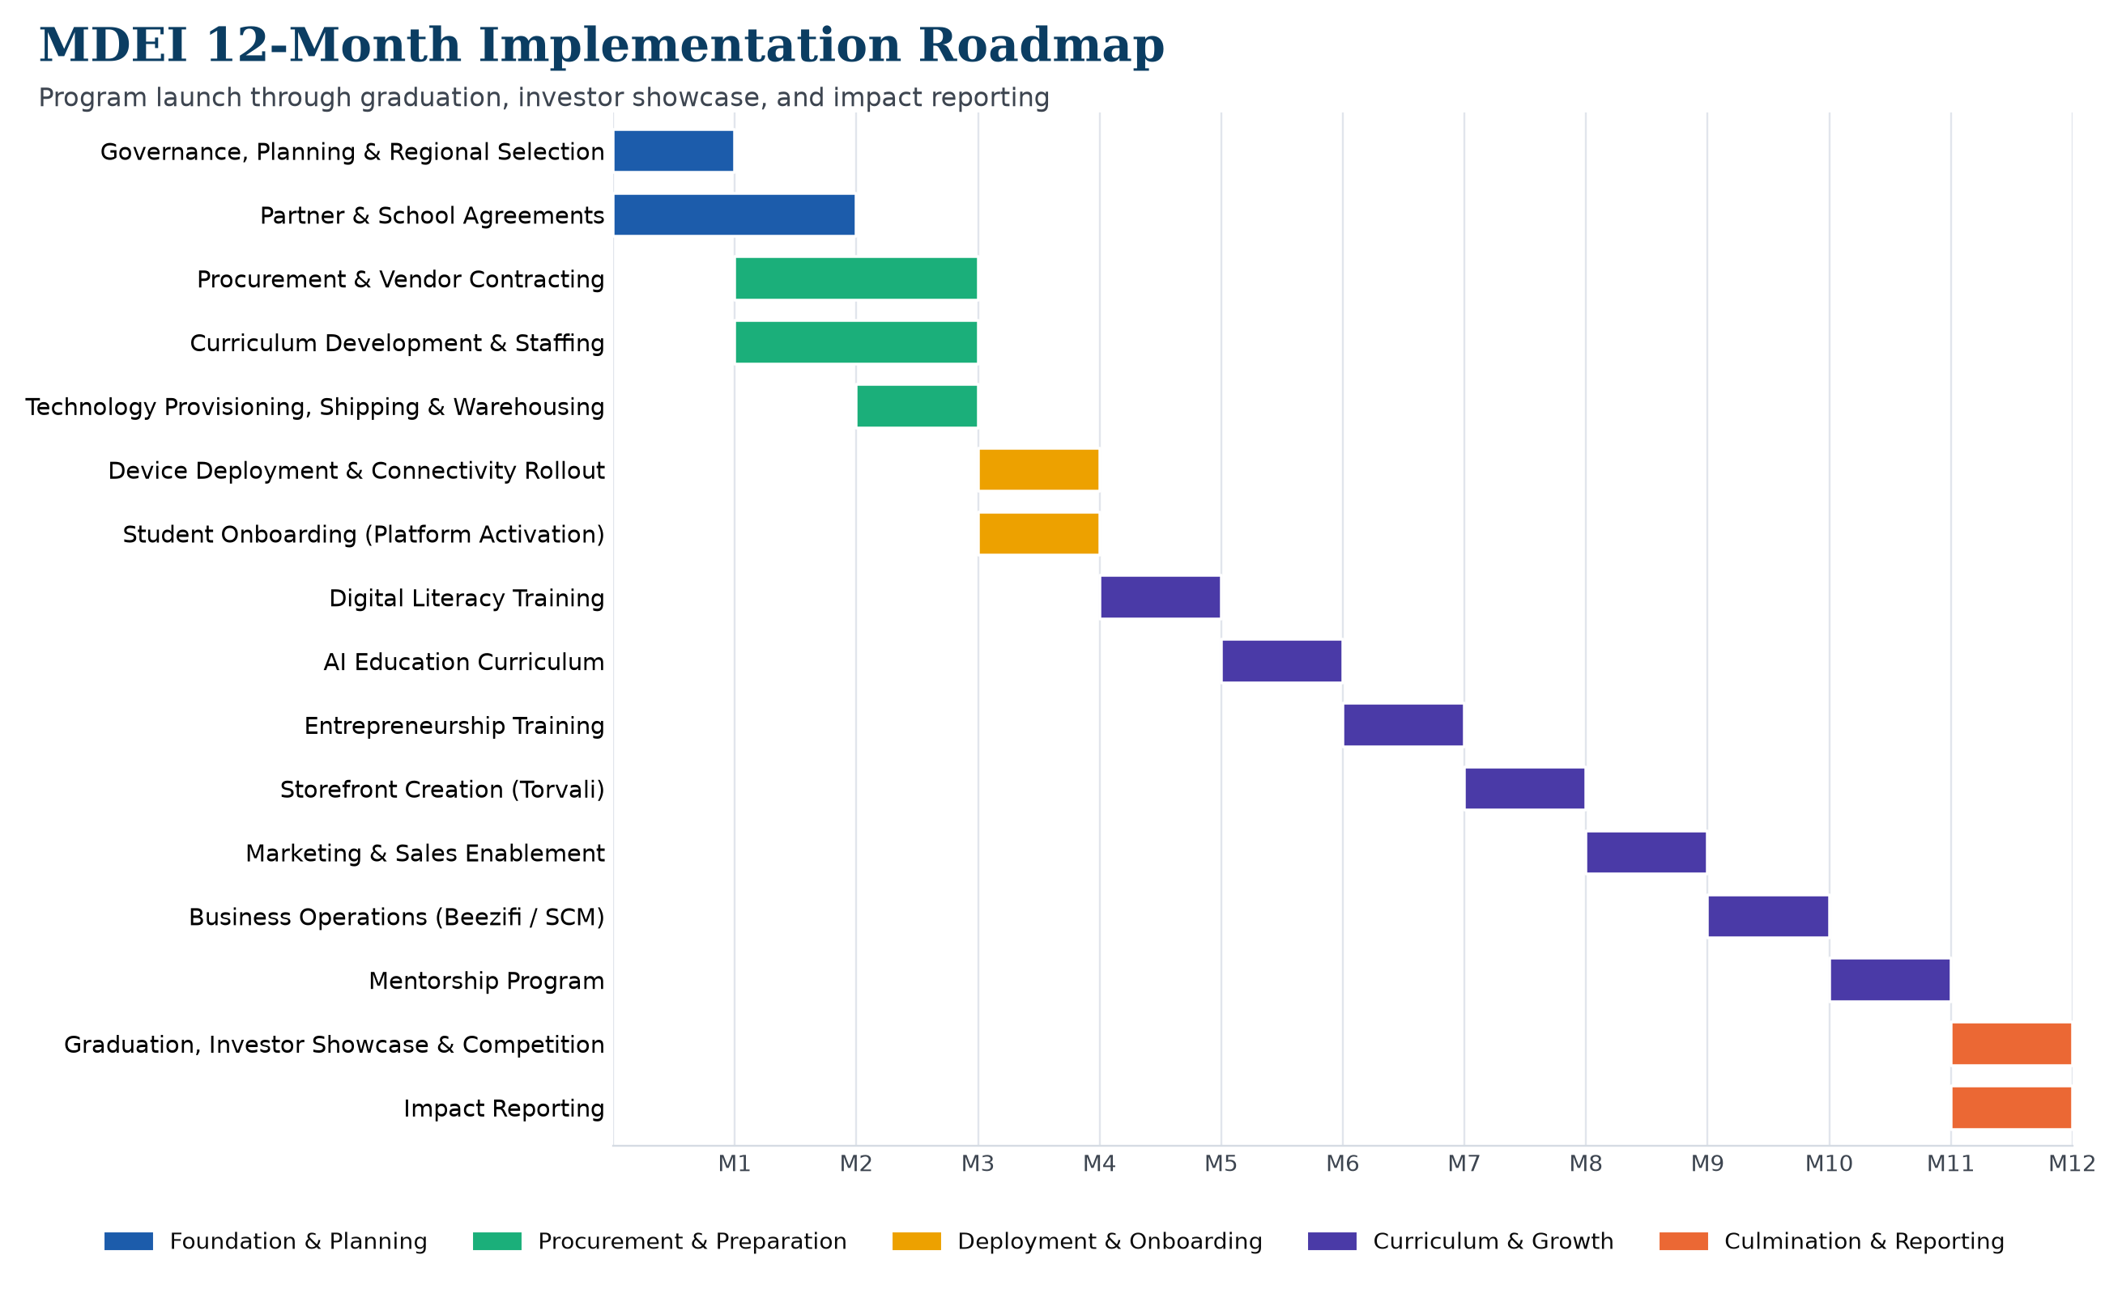
12-Month Implementation Roadmap
Catholic Project Fund · MDEI Stakeholder Presentation
14

Slide 15
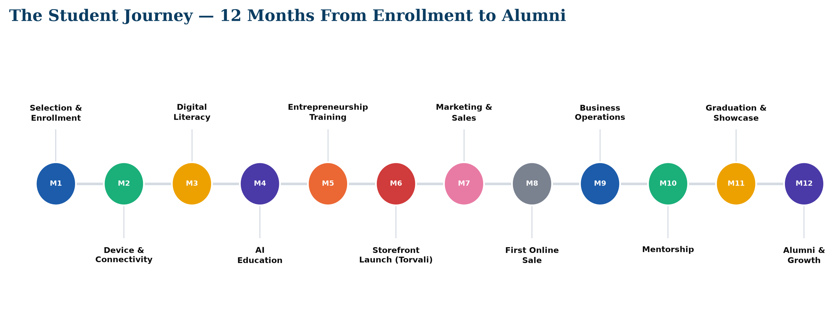
The Student Journey
Catholic Project Fund · MDEI Stakeholder Presentation
15

Slide 16
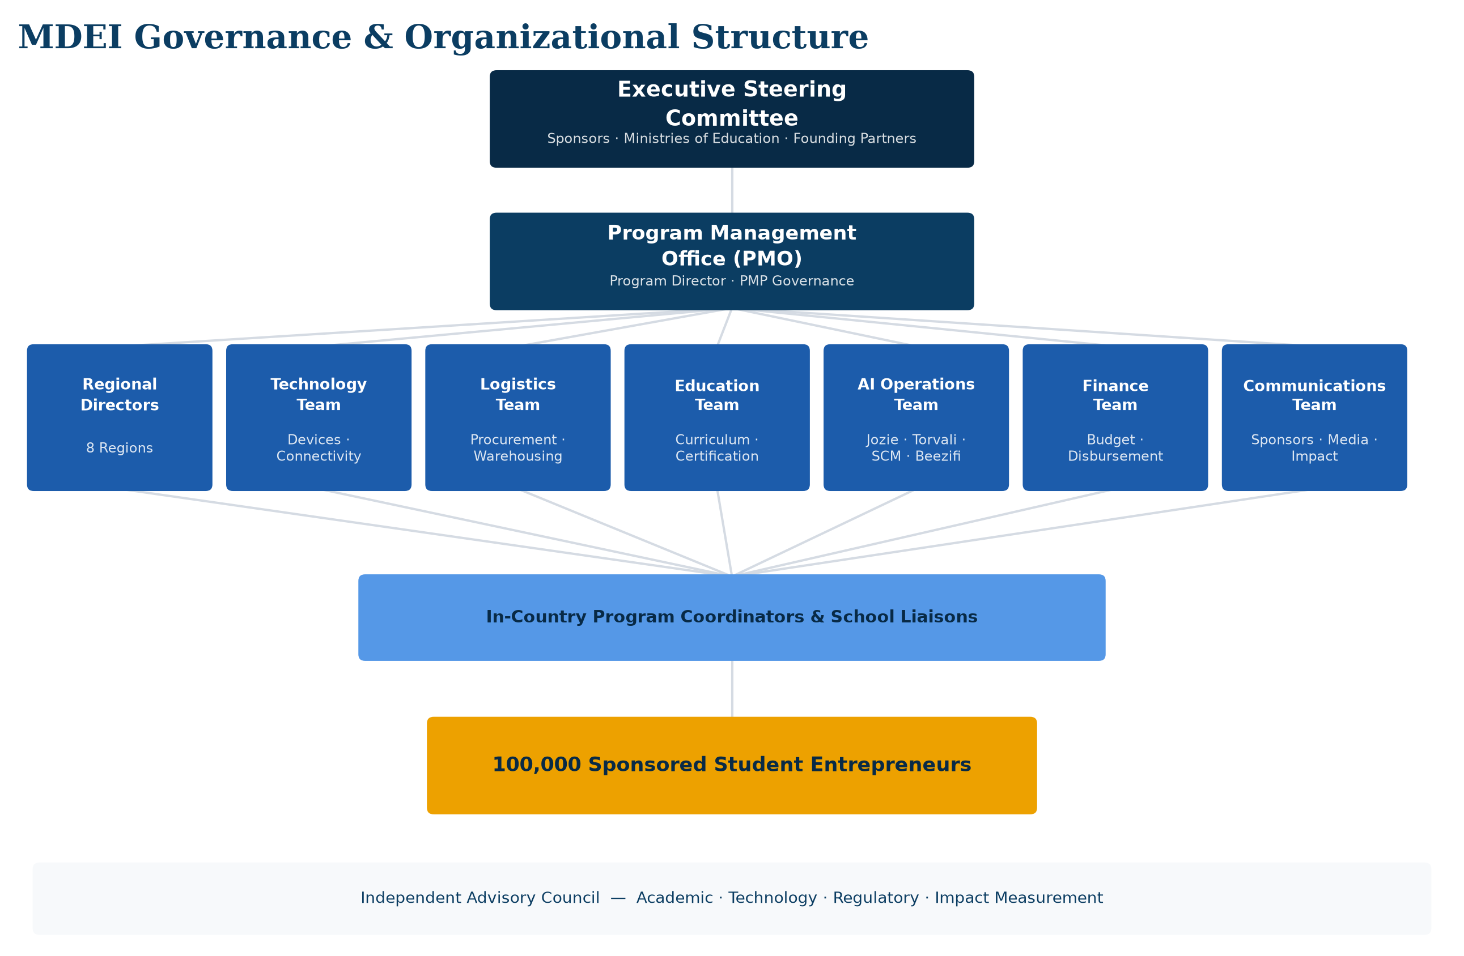
Governance & Organizational Structure
Catholic Project Fund · MDEI Stakeholder Presentation
16

Slide 17
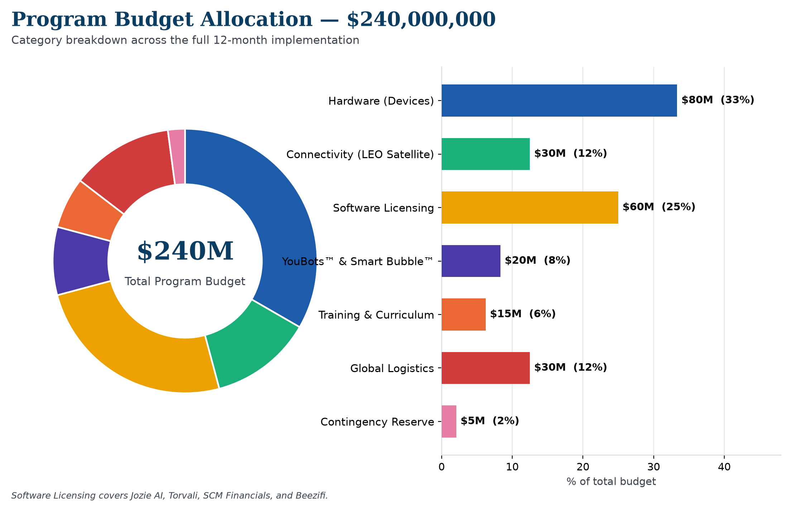
Program Budget — $240,000,000
Catholic Project Fund · MDEI Stakeholder Presentation
17

Slide 18
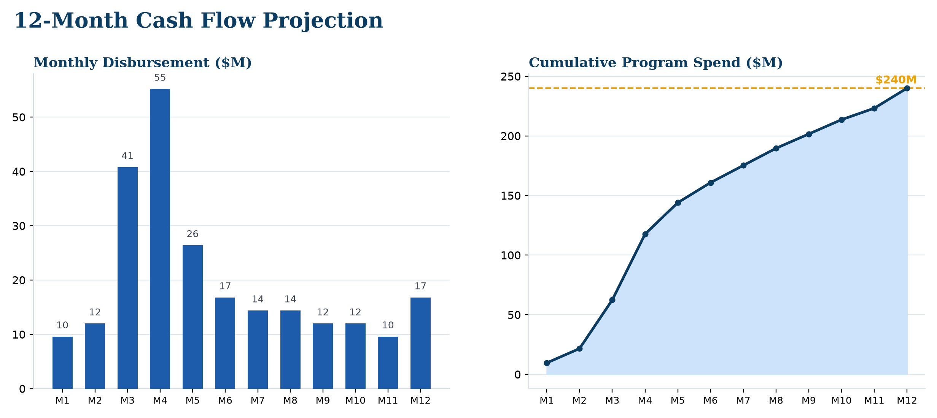
Cash Flow Projection
Catholic Project Fund · MDEI Stakeholder Presentation
18

Slide 19
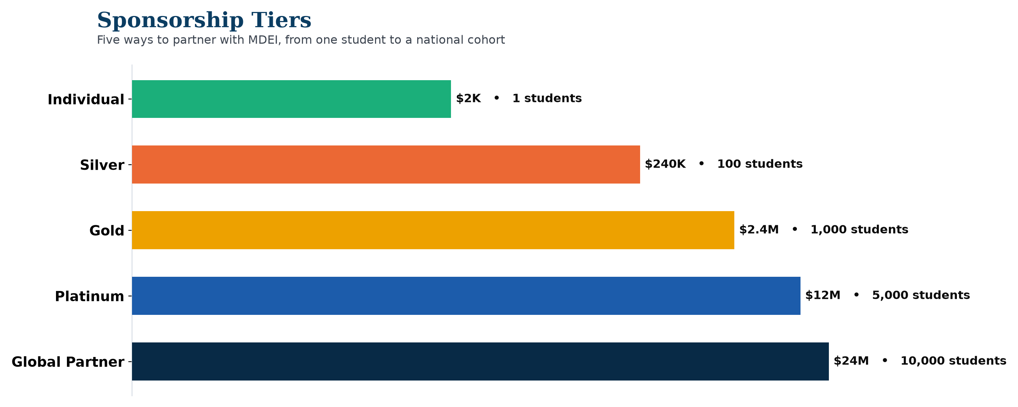
Sponsorship Tiers
Catholic Project Fund · MDEI Stakeholder Presentation
19

Slide 20
Sponsorship Benefits Matrix
Benefit | Global Partner | Platinum | Gold | Silver | Individual
Named recognition | ✓ | ✓ | ✓ | ✓ | —
Logo on annual report cover | ✓ | ✓ | — | — | —
Steering Committee seat | ✓ | — | — | — | —
Audited financials | ✓ | ✓ | ✓ | — | —
Quarterly program report | ✓ | ✓ | ✓ | ✓ | ✓
Investor showcase invite | ✓ | ✓ | ✓ | ✓ | —
Catholic Project Fund · MDEI Stakeholder Presentation
20

Slide 21
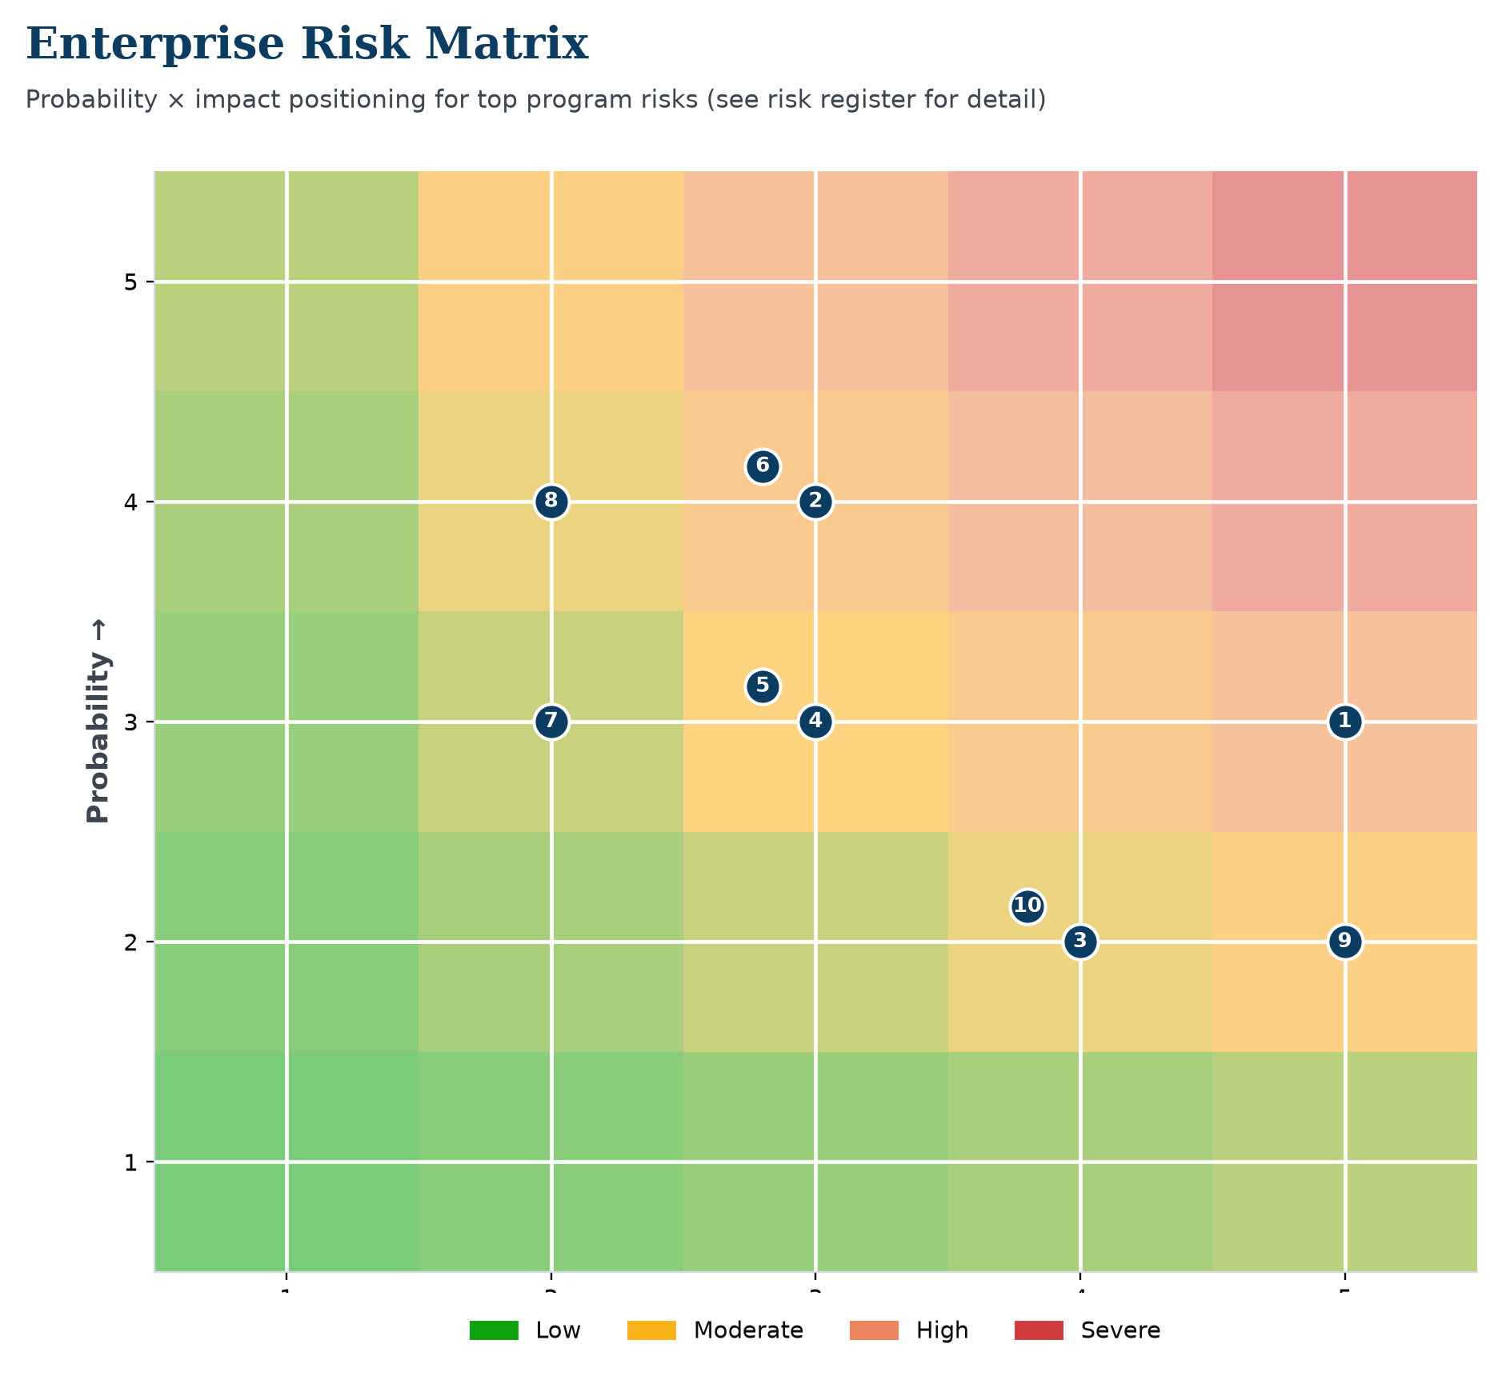
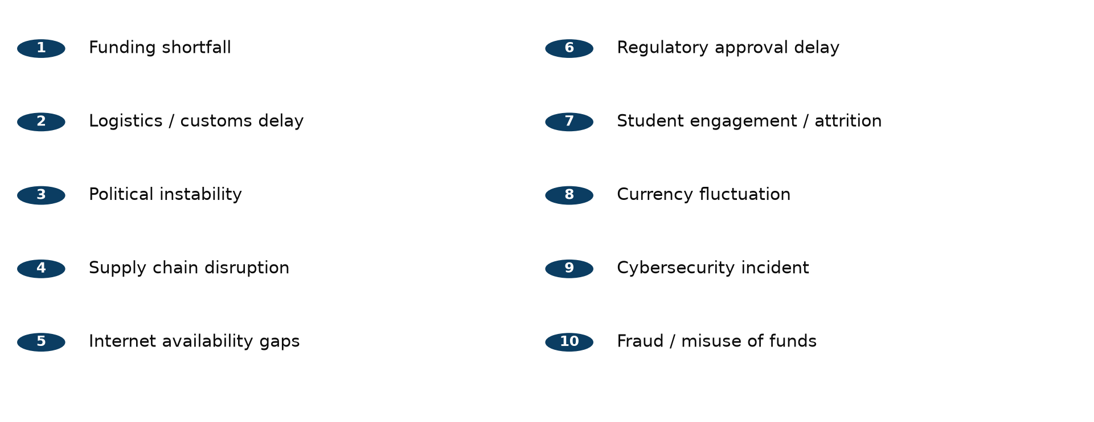
Enterprise Risk Matrix
Catholic Project Fund · MDEI Stakeholder Presentation
21

Slide 22
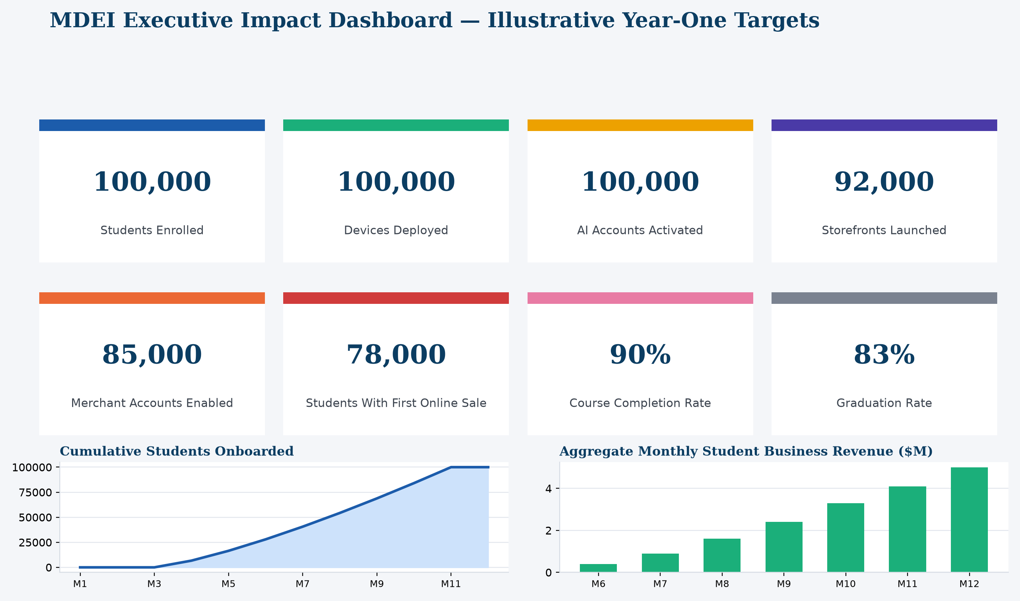
MONITORING & EVALUATION
Executive Impact Dashboard
Catholic Project Fund · MDEI Stakeholder Presentation
22

Slide 23
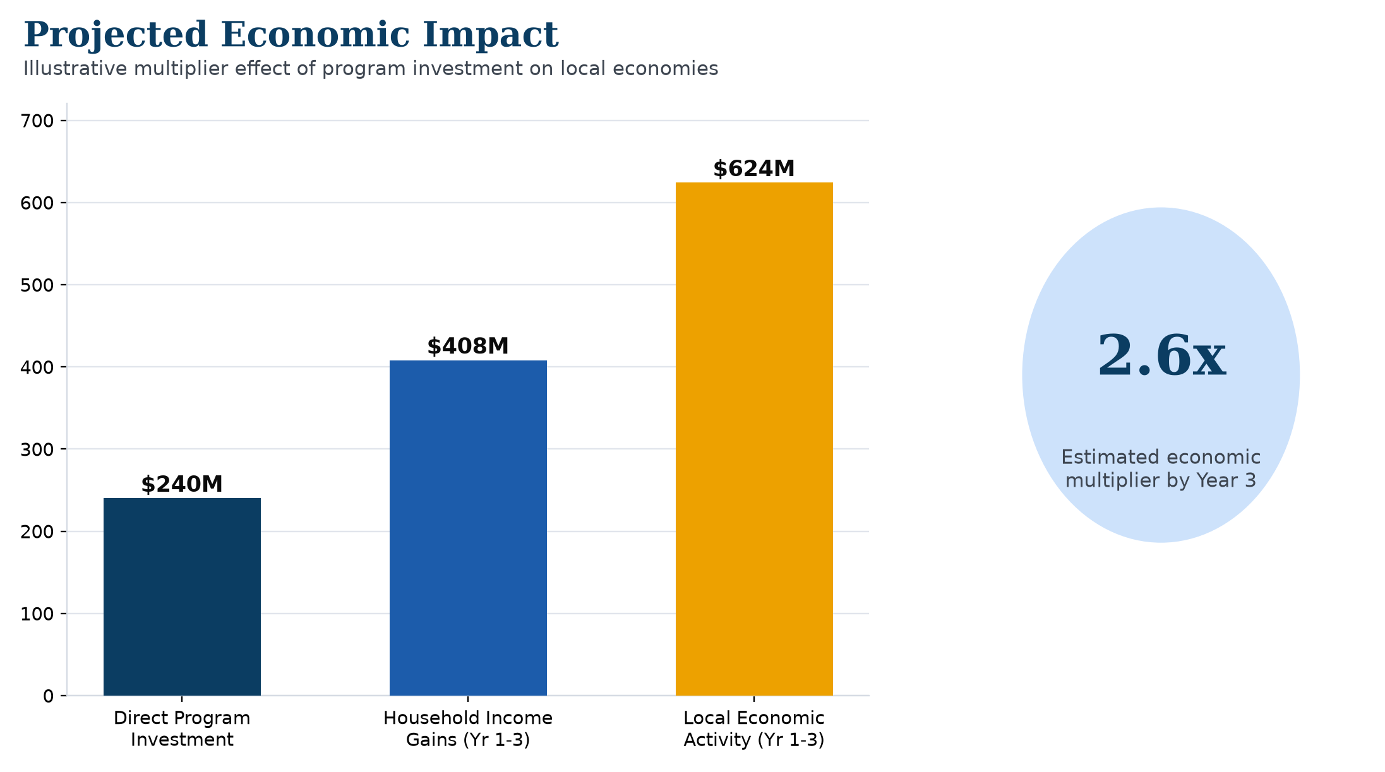
Expected Impact
Catholic Project Fund · MDEI Stakeholder Presentation
23

Slide 24
Sustainability Plan
› Continued platform access — discounted alumni continuation pricing for Jozie, Torvali, SCM Financials, Beezifi & YouLabs
› Local partnerships — chambers of commerce, microfinance institutions, and vocational bodies
› Reinvestment & alumni network — graduates mentor and sponsor the next cohort
› Mentorship & growth — Month 11 mentors commit to 6+ months of continued informal support
Catholic Project Fund · MDEI Stakeholder Presentation
24

Slide 25
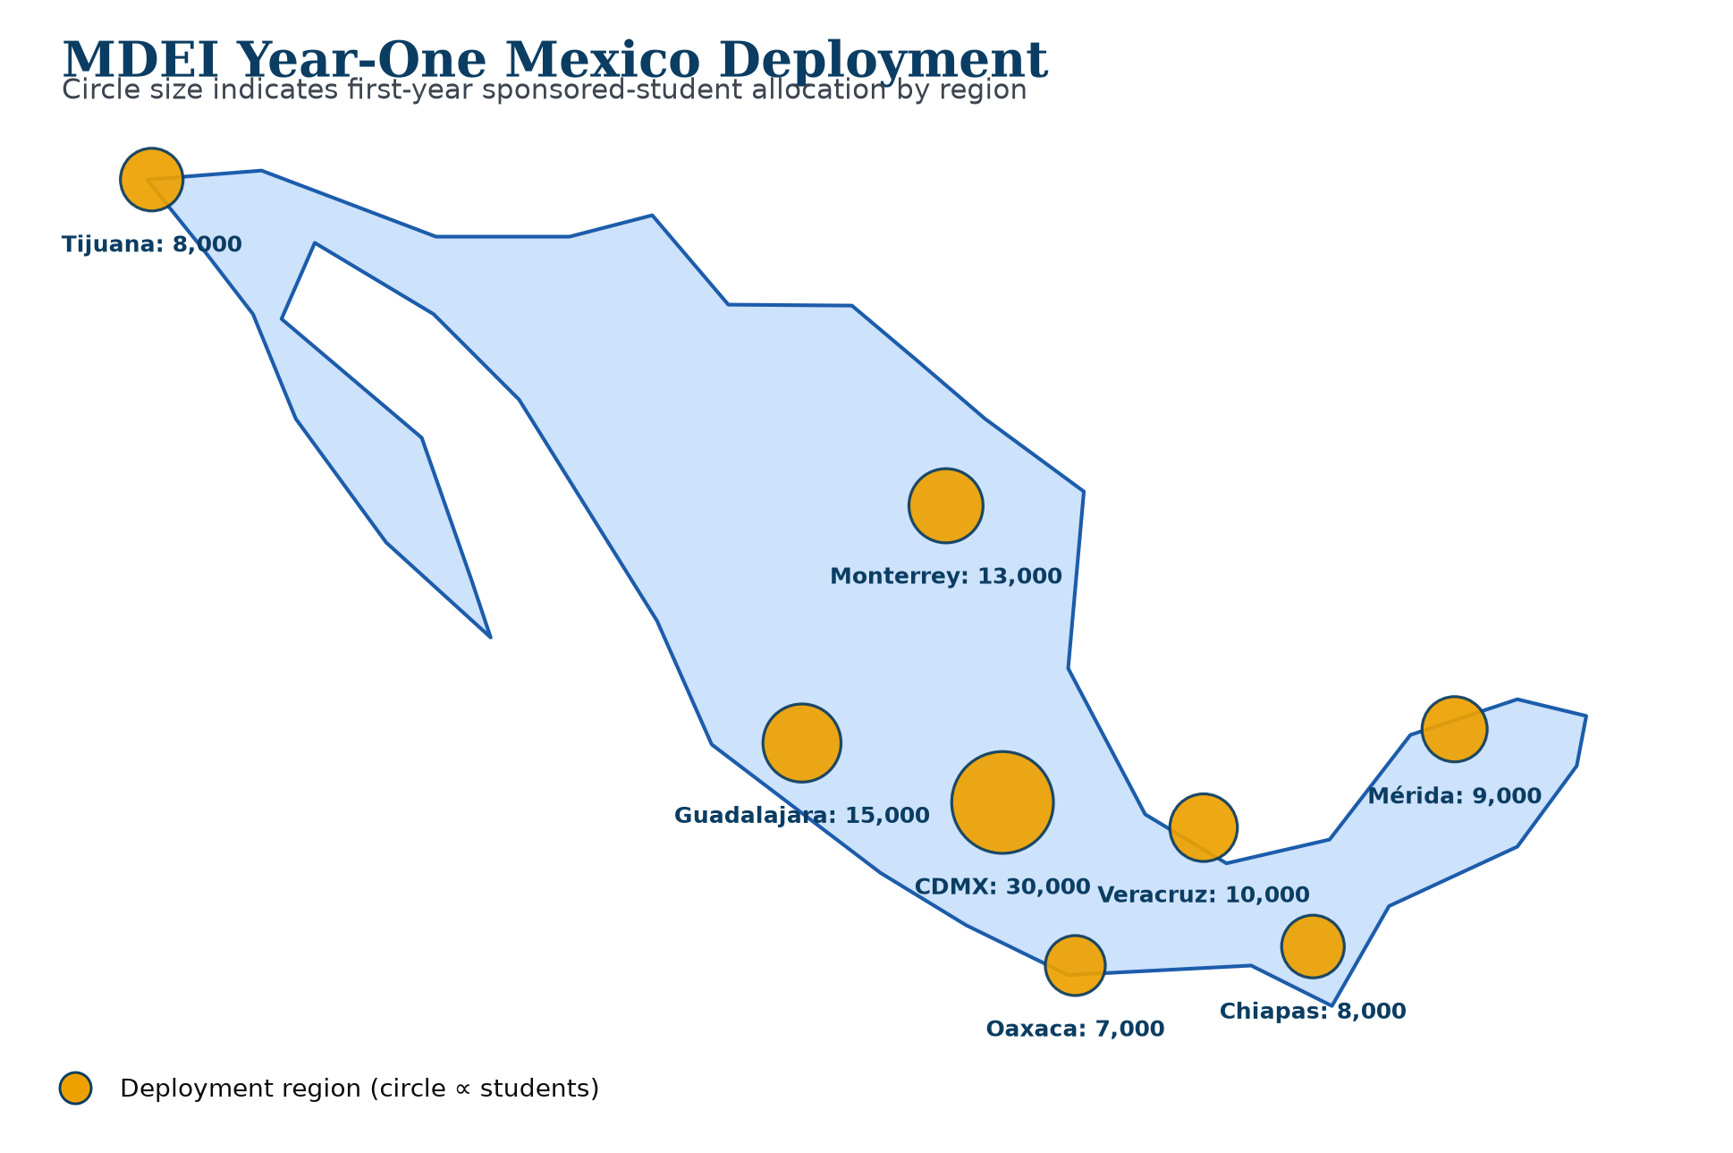
Mexico Deployment Plan
Greater Mexico City
30,000
Jalisco (Guadalajara)
15,000
Nuevo León (Monterrey)
13,000
Veracruz
10,000
Yucatán (Mérida)
9,000
Baja California
8,000
Chiapas
8,000
Oaxaca
7,000
Catholic Project Fund · MDEI Stakeholder Presentation
25

Slide 26
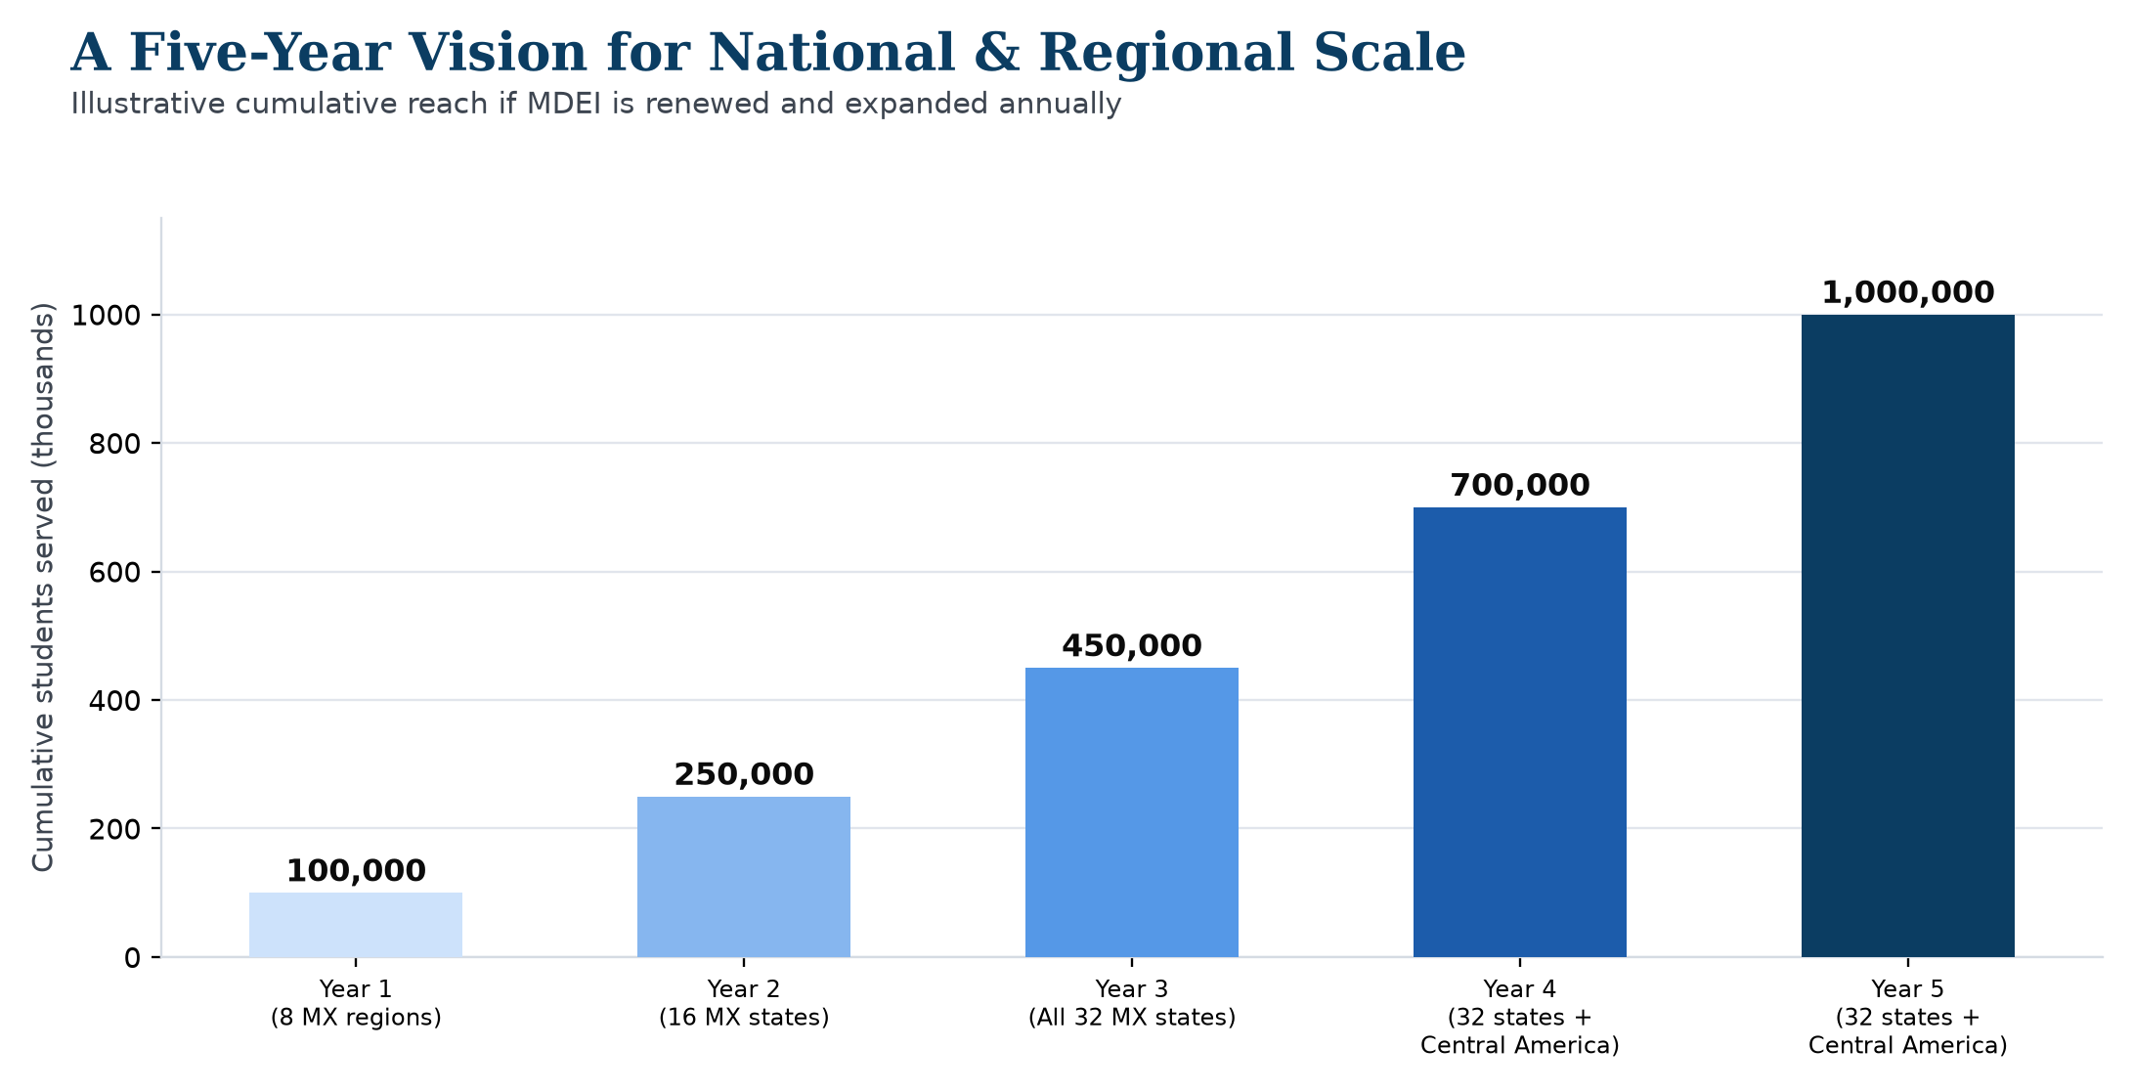
A Five-Year Vision
Catholic Project Fund · MDEI Stakeholder Presentation
26

Slide 27
Join Us
A transparent $2,400 unit of investment that scales from a single sponsor to a $24,000,000 Global Partner commitment — with quarterly reporting against every KPI in this presentation.
NEXT STEPS
› Contact the Catholic Project Fund Partnerships Office to discuss tier and region preference
› Execute a partnership agreement outlining terms and reporting cadence
› Receive recognition placement and your first quarterly report after Month 1 governance close
Catholic Project Fund · MDEI Stakeholder Presentation
27

Slide 28
Thank You
Catholic Project Fund Partnerships Office
Mexico Digital Entrepreneurship Initiative (MDEI) · July 2026

