Slide 1

THE Global Supply Chain Exchange
GSCX Impact Summary
Problem, solution, and benefits for
inclusive global trade
From exclusion
to economic participation

Slide 2
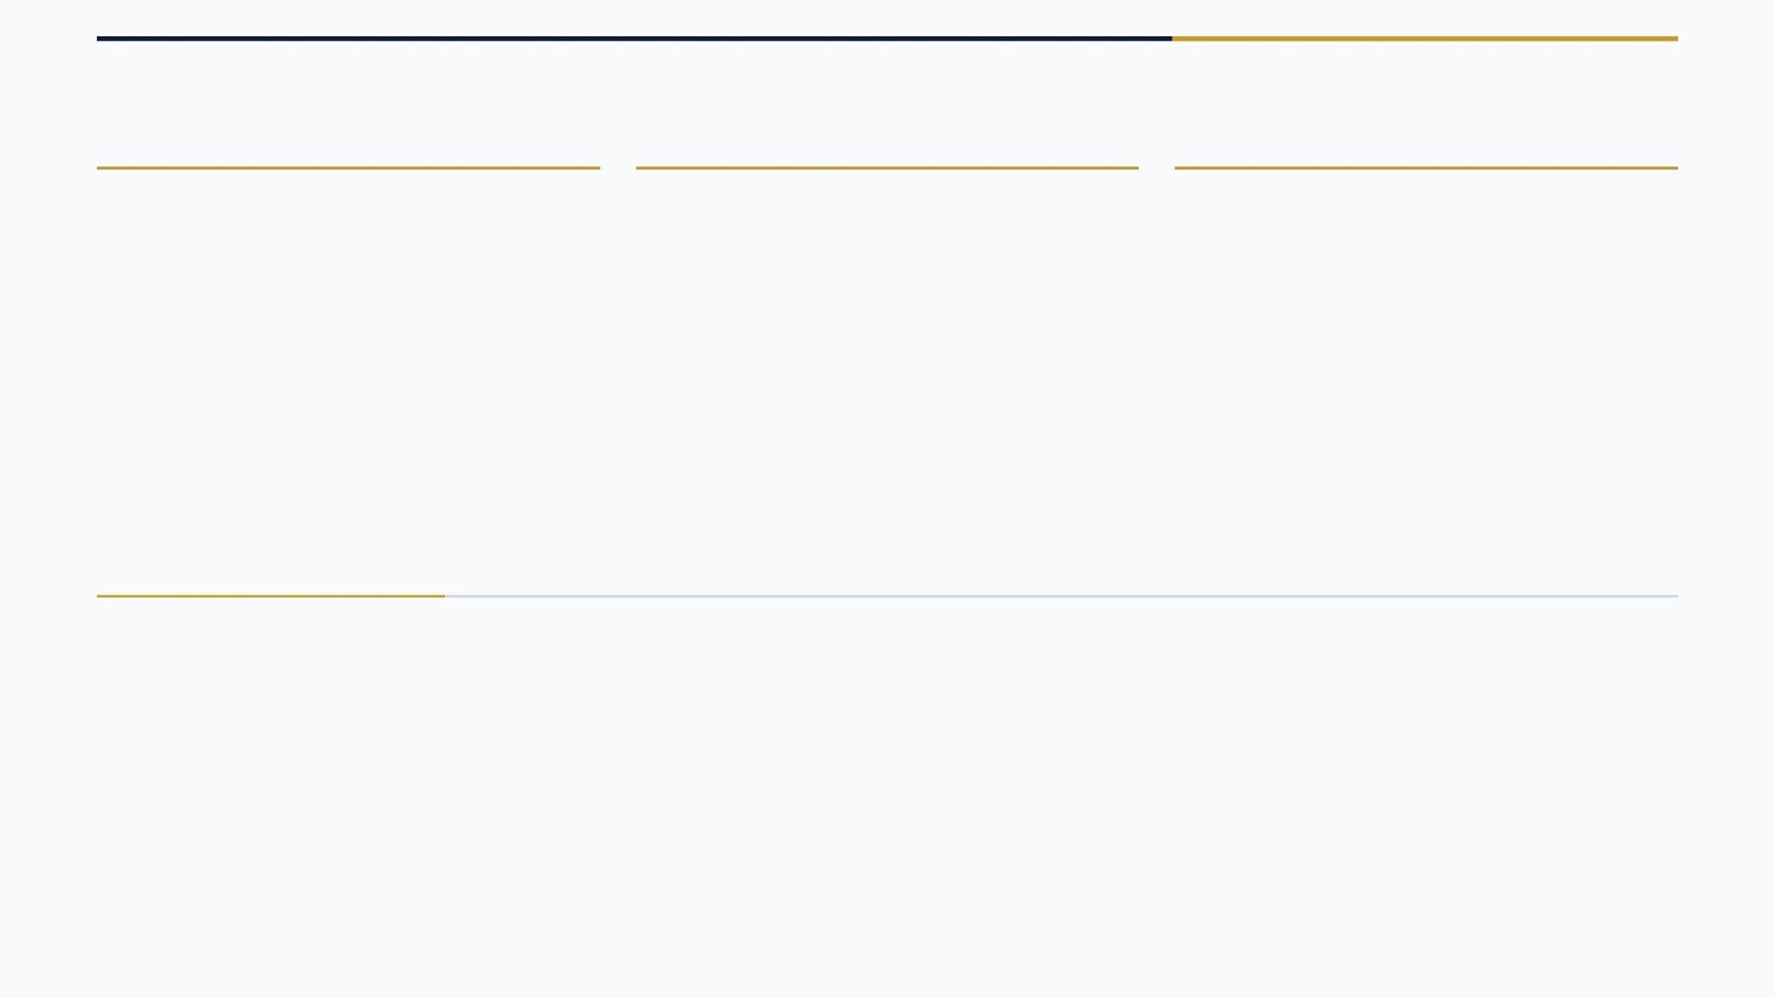
HUMAN IMPACT FOCUS
GSCX Turns Exclusion Into Economic Participation
1) Problem and Human Impact
2) GSCX Solution
•
Viable businesses are ready to trade, but many are blocked by unreliable access to trusted hard-currency infrastructure.
•
GSCX proposes a trusted institutional exchange connecting trade, capital, compliance, insurance, and settlement.
•
This exclusion leaves entrepreneurs, workers, and communities outside formal global trade.
•
The solution makes global trade more secure, transparent, efficient, and accessible for excluded businesses.
•
Informal currency channels create inflated costs, delayed settlement, greater risk, and lost confidence.
•
GSCX aims to create trusted trade corridors connecting buyers, sellers, capital providers, insurers, and compliance partners.
•
Stalled production, exports not shipped, jobs not created, and prosperity withheld from underserved markets.
•
The platform expands reliable participation in global commerce while reducing friction, risk, and exclusion.
3) Accomplishments and Benefits
•
Broader financial inclusion for businesses, workers, and communities denied fair access to trade.
•
Participation in a £25T+ trade-finance opportunity while closing a large global liquidity and access gap.
•
Implementation could convert unmet demand into financed production, shipped exports, and job creation.
•
Indirect benefits include stronger regulated markets, resilient capital flows, reduced exploitation, greater trust, long-term wealth creation, and decreased world conflict.

Slide 3
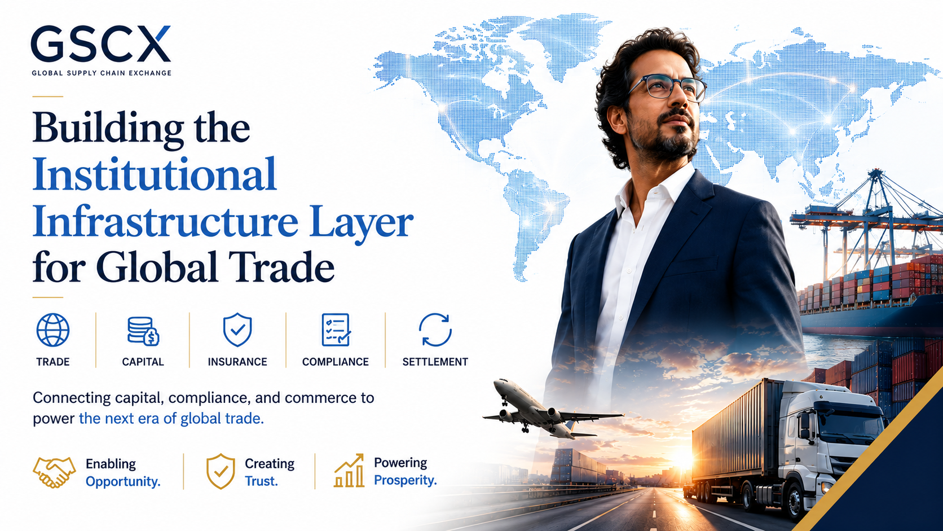

Slide 4
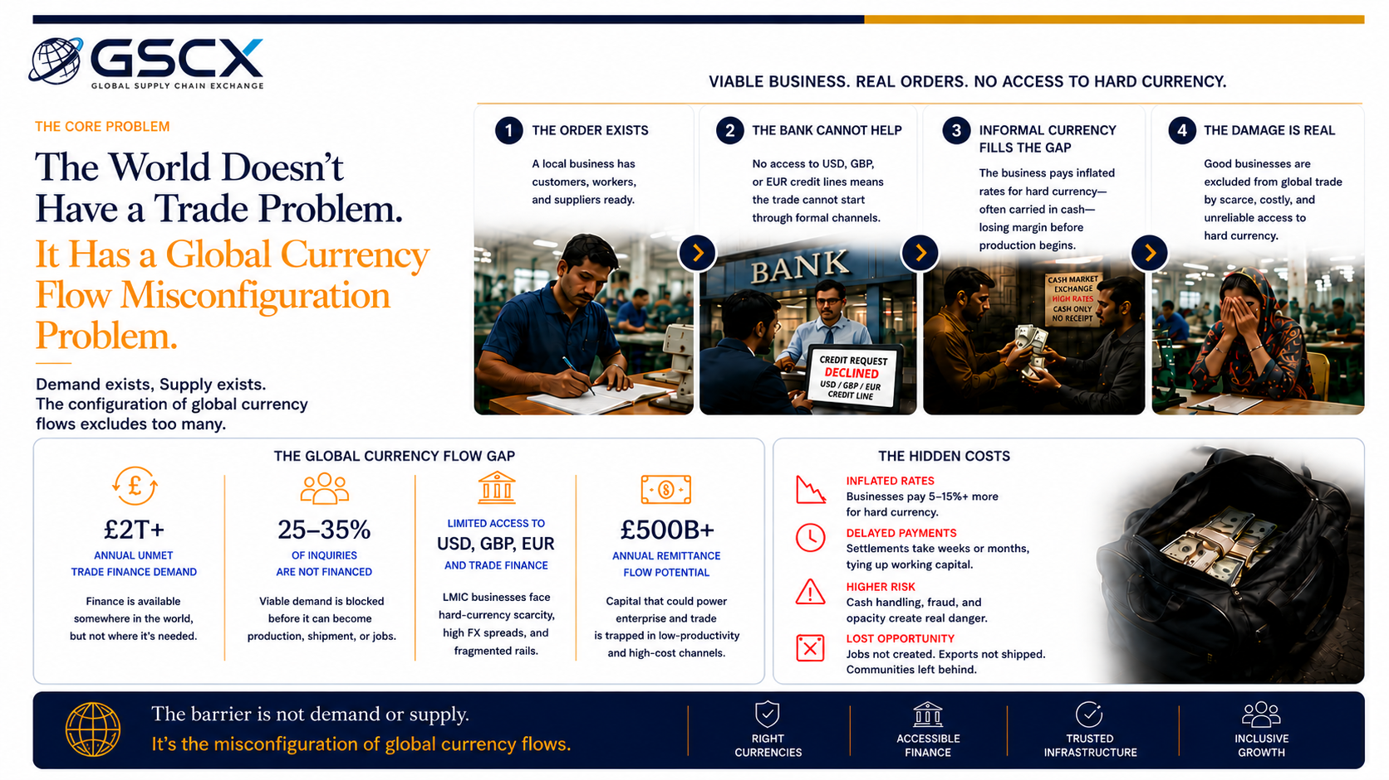

Slide 5
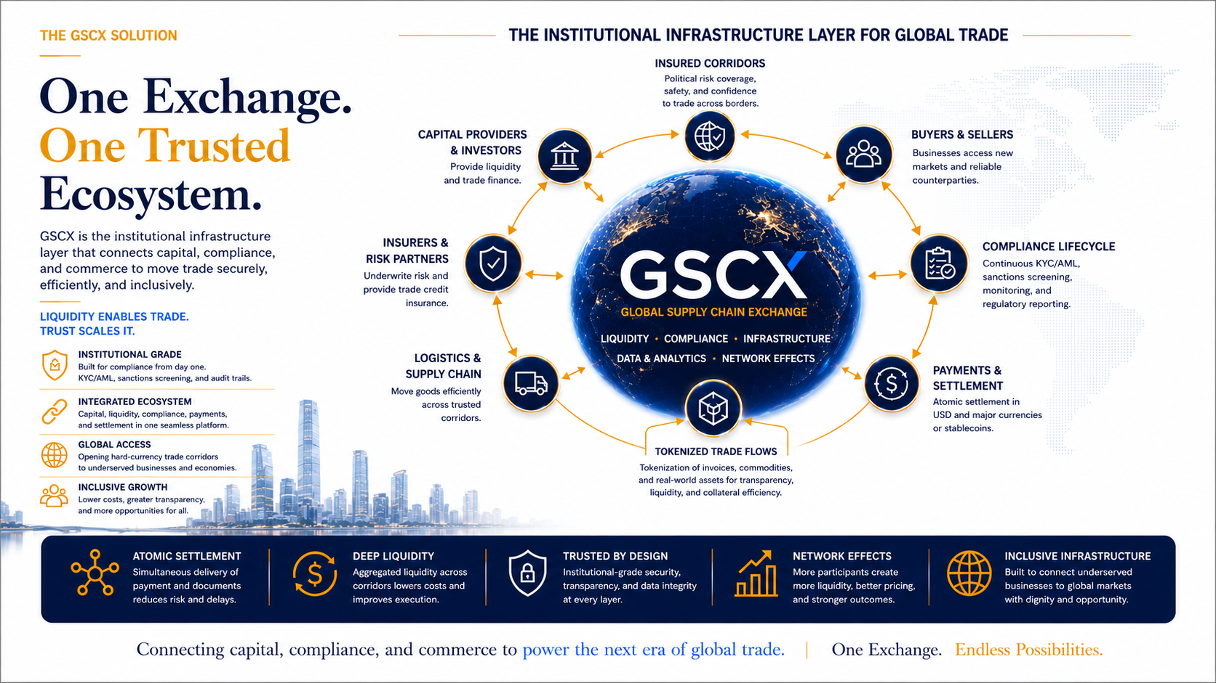

Slide 6
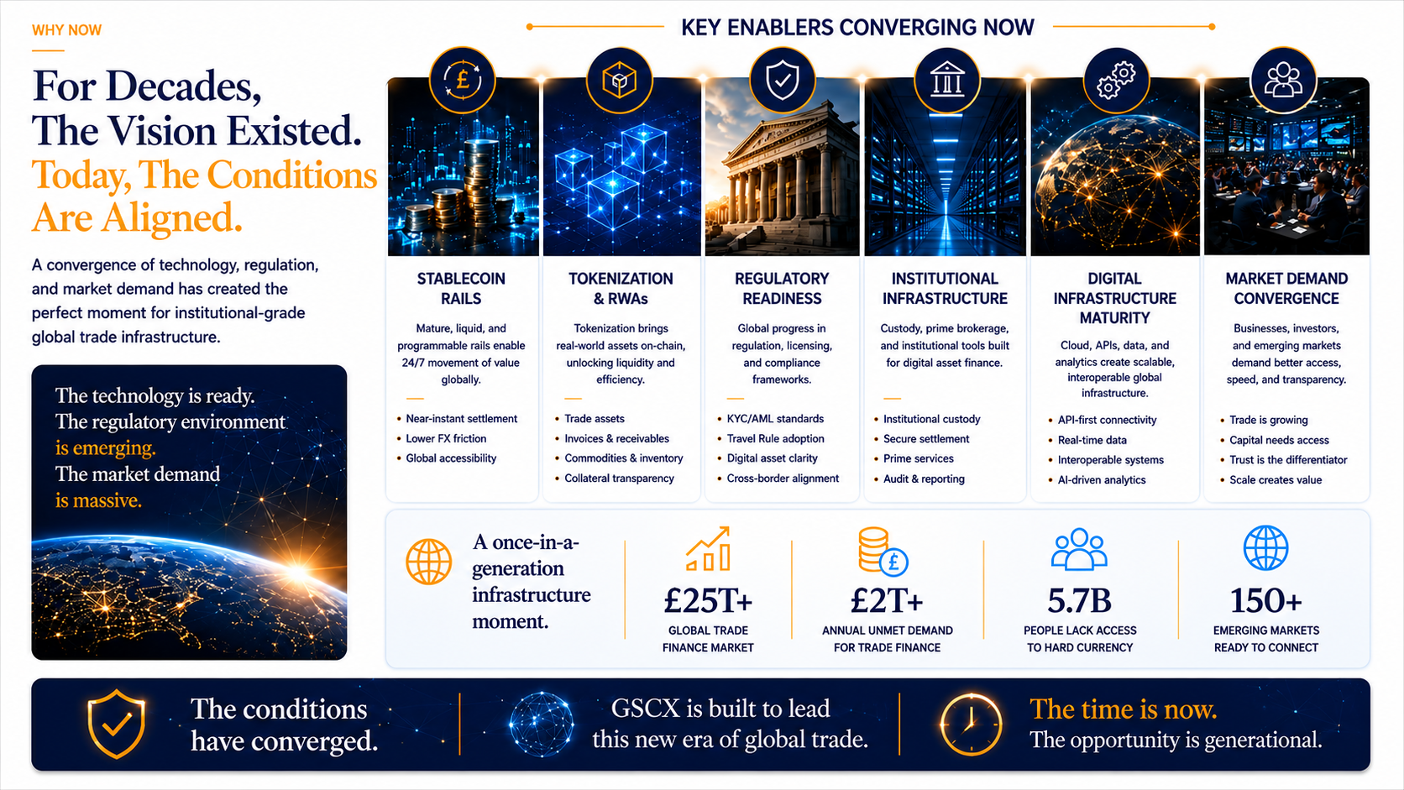

Slide 7
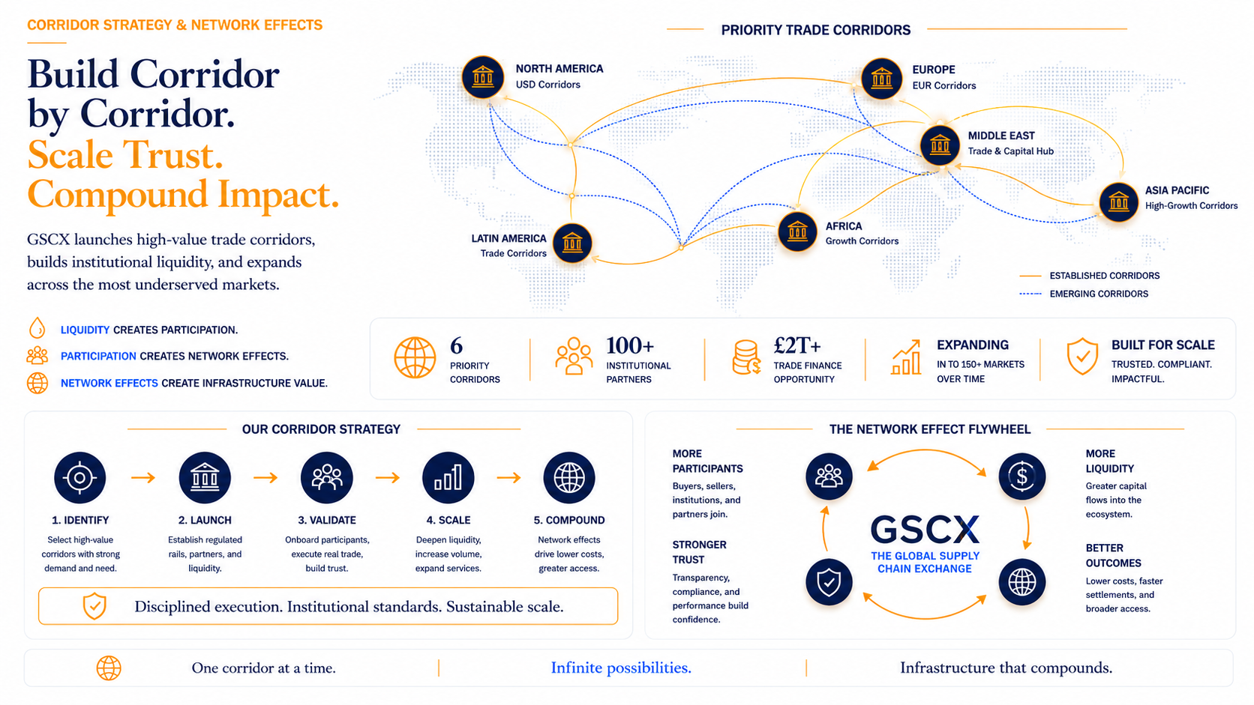

Slide 8
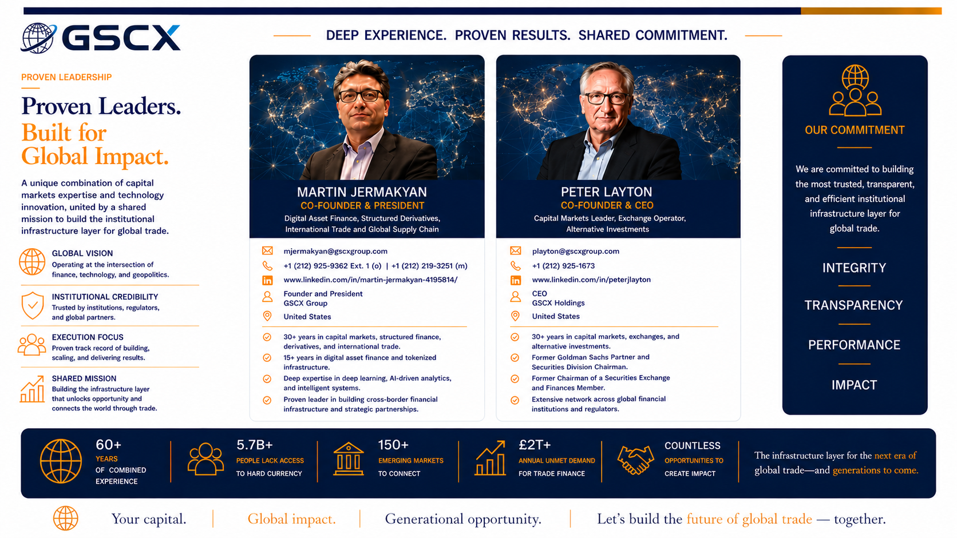

Slide 9
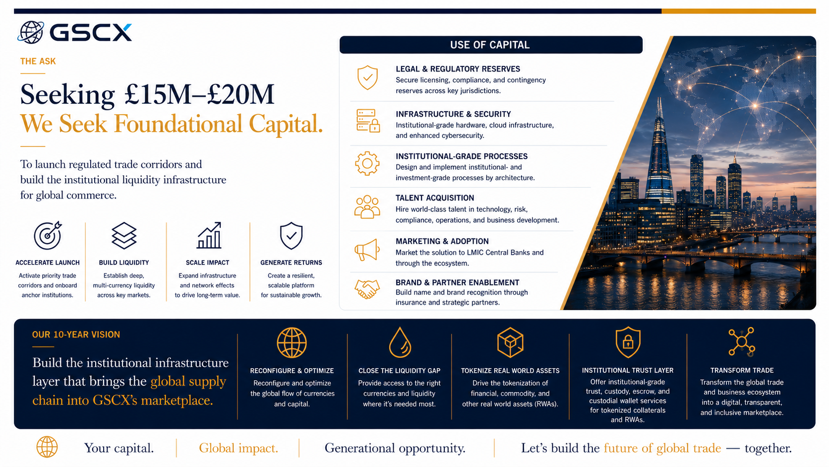

Slide 10
